Slide 1


Early Detection of Alzheimer’s Disease
“Early Detection Saves Futures.”
Notes:
Note:
1

Slide 2
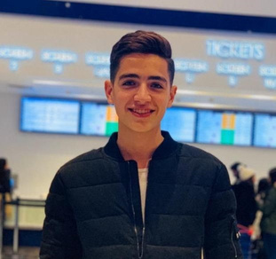
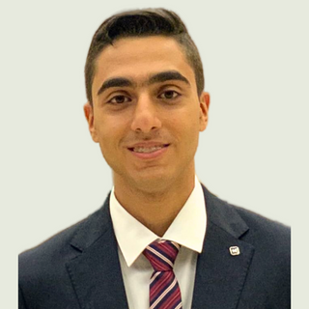


Team Members
Mostafa Abdelsattar
Youssef Tamer
Ahmed Ayman
Under Supervision: Eng. Aya Nada
Samsung Innovation Campus

Slide 3
Agenda
Problem Statement
Understanding The Data
Data Preparation
Data Preprocessing
Modeling & Performance
Insights & summary
Deployment
Samsung Innovation Campus

Slide 4
Problem Statement
Samsung Innovation Campus
Notes:
Note:
2

Slide 5

Problem Statement
"Alzheimer’s disease is one of the most widespread and devastating disorders worldwide.
It affects millions of individuals every year and places an enormous emotional, social, and financial burden on patients, families, and healthcare systems. As the disease progresses, memory loss, cognitive decline, and functional impairment gradually take away a person’s independence and quality of life"
Samsung Innovation Campus

Slide 6
Understanding The Data
Samsung Innovation Campus

Slide 7
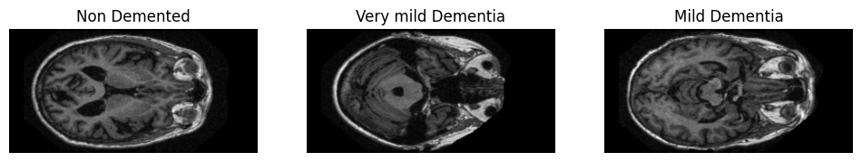
Understanding the Data
The dataset used in this project contains 85,949 brain MRI images distributed across three categories representing different cognitive conditions:
The class counts are as follows:
Non-Demented: 67,222 images
Very Mild Dementia: 13,725 images
Mild Dementia: 5,002 images
These images are grayscale medical scans that provide structural information about the brain.
Samsung Innovation Campus

Slide 8
Data Preparation
Samsung Innovation Campus

Slide 9
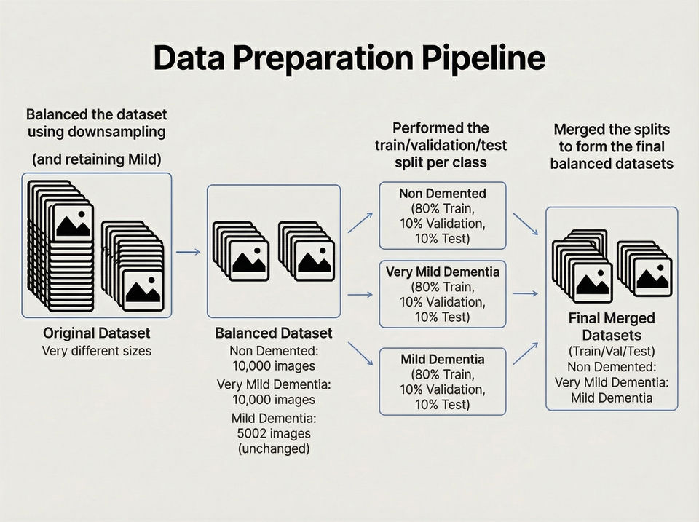
Data Preparation
Samsung Innovation Campus

Slide 10
Data Preprocessing
Samsung Innovation Campus
Notes:
Note:
2

Slide 11
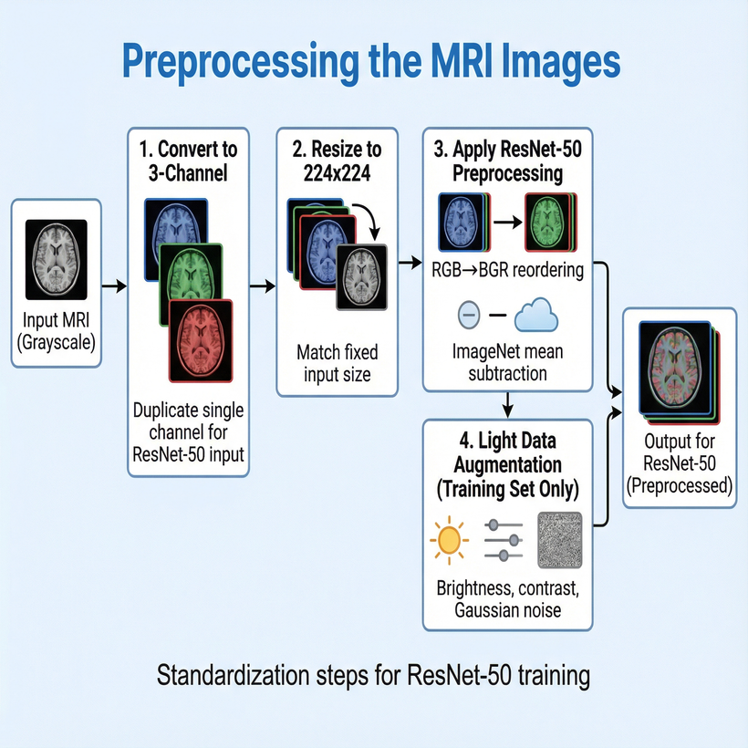
Data Preprocessing
Samsung Innovation Campus

Slide 12
Modeling and Evaluation
Samsung Innovation Campus
Notes:
Note:
2

Slide 13
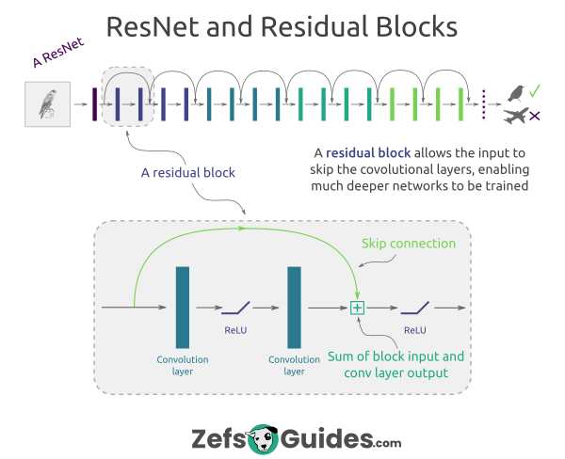
Architecture Deep Dive: ResNet (Residual Network)
The Residual Block
Skip Connections: ResNet introduces identity mapping paths that bypass one or more layers.
Solves Degradation: These "shortcuts" allow information from earlier layers to be passed directly to deeper layers, combating the problem of vanishing gradients and enabling training of very deep networks.
Learning Identity: The block learns a residual function $F(x) = H(x) - x$, meaning the layer only needs to learn the difference, $H(x)$, from the input $x$.
Samsung Innovation Campus
Notes:
Note:
9

Slide 14
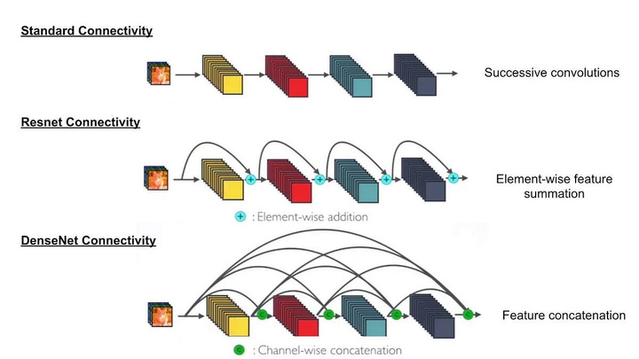
Architecture Deep Dive: DenseNet (Densely Connected Network)
Feature Reuse and Efficiency
Dense Connectivity: Each layer in a Dense Block receives feature maps from all preceding layers in that block, and passes its own feature maps to all subsequent layers.
Maximum Feature Reuse: This deep supervision encourages features to be reused throughout the network, making the network highly parameter-efficient.
Vanishing Gradient Mitigation: The direct connections provide multiple short paths for the gradient to flow back.
Test and Evaluation
Samsung Innovation Campus
Notes:
Note:
9

Slide 15
Mitigation Strategy: Weighted Cross-Entropy Loss
Calculating Class Weights
To force the model to prioritize learning the rare class ‘mild’, we calculate inverse class frequencies to generate a loss penalty.
Test and Evaluation
Purpose: Ensures the loss contribution of a single misclassified Mild Dementia image is equal to or greater than that of many Non-Demented images.
Samsung Innovation Campus
Notes:
Note:
9

Slide 16
DenseNet: Phase 1 Model Construction (Transfer Learning)
Feature Extractor: Used `DenseNet121` initialized with ImageNet weights.
Head Only Training: This step is crucial it freezes the weights of the entire DenseNet backbone.
New Head: A small custom head (GAP, Dense, Dropout) is stacked on top and is the only part trained in Phase 1.
Low LR: Adam optimizer started with low learning rate.
Test and Evaluation
Samsung Innovation Campus
Notes:
Note:
9

Slide 17
DenseNet Training: Advanced Callback Strategy
Custom F1-Score Callback
Given the imbalance, a custom callback was implemented to track the weighted F1-score a more robust metric than accuracy and save the best model based on its performance.
Test and Evaluation
Standard Callbacks Used:
Checkpoint: Saves best model based on `val_loss`.
EarlyStopping: Halts training after 5 epochs of no `val_loss` improvement.
Samsung Innovation Campus
Notes:
Note:
9

Slide 18
Resnet Training Strategy & Optimized Callbacks
Optimized Training Callbacks
For the final ResNet model, we utilized a streamlined set of callbacks with adjusted parameters for higher stability and patience, reflecting a more stable architecture.
Test and Evaluation
Model Fit Call
The ResNet model was trained end-to-end using the same class weights to ensure balanced learning.
Samsung Innovation Campus
Notes:
Note:
9

Slide 19
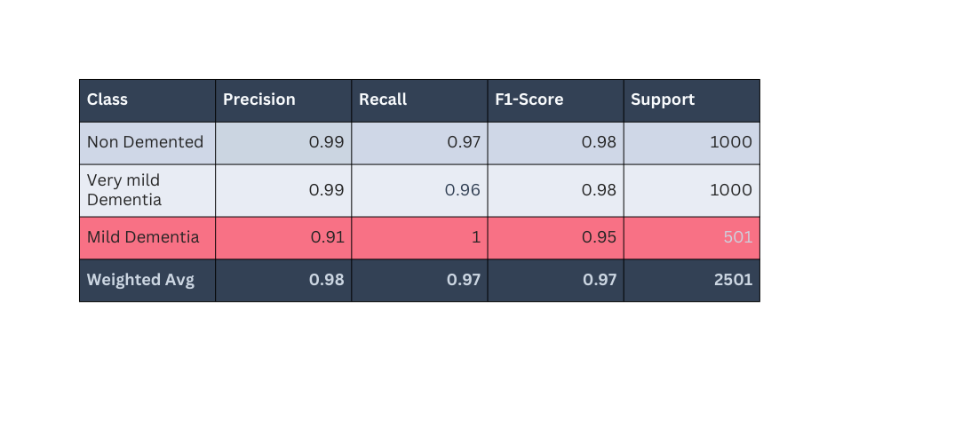
DenseNet: Optimized Training Execution (The Final Model)
The DenseNet model achieved suspicious performance metrics, particularly on the minority class, indicating a failure to generalize robustly.
Test and Evaluation
Critical Observation: Achieving 100% Recall on the smallest class (Mild Dementia) is highly unrealistic. This suggests the model has memorized specific features unique to the test data, indicating data leakage or severe overfitting, not robust generalization.
Samsung Innovation Campus
Notes:
Note:
9

Slide 20
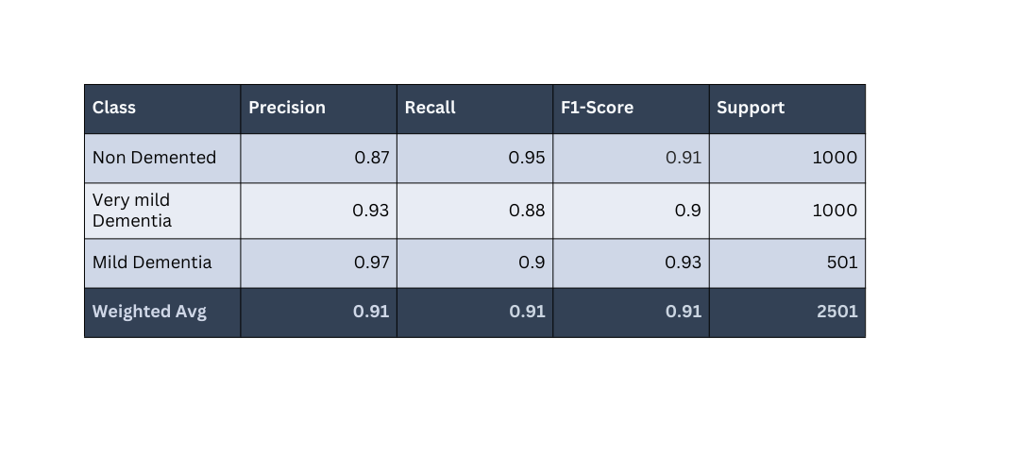
ResNet Results: Robust Generalization
The ResNet model achieved highly reliable metrics, showing good, balanced performance across all classes, indicating true generalization.
Key Metric: Weighted F1-Score of 0.91 is reliable. Note the strong Recall (Sensitivity) of 0.90 for the critical Mild Dementia class.
Samsung Innovation Campus
Notes:
Note:
9

Slide 21
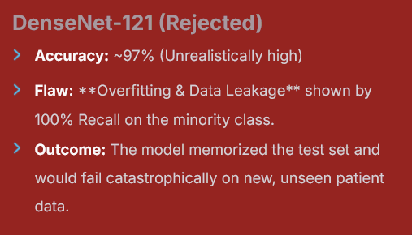
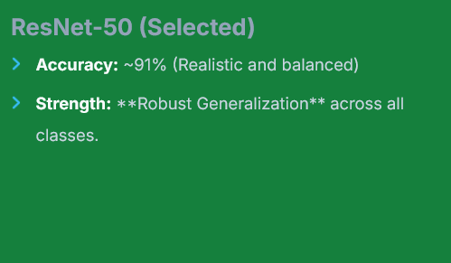
Final Model Selection: ResNet-50 vs. DenseNet-121
Samsung Innovation Campus
Notes:
Note:
9

Slide 22
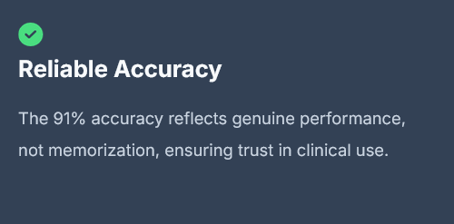
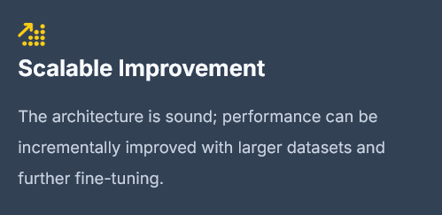
ResNet: The Future-Proof Solution
The ResNet-50 model is chosen for its superior ability to generalize, which is non-negotiable for a diagnostic tool.
Samsung Innovation Campus
Notes:
Note:
9

Slide 23
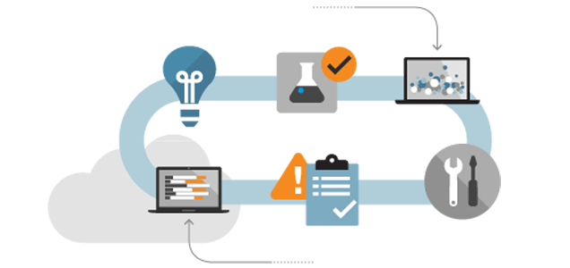

From Script to Product: Deployment
Deployment framework
The ML model is wrapped and served via a Streamlit app, instead of a separate API + frontend + container stack.
Samsung Innovation Campus
Notes:
Note:
9

Slide 24
Demo
Samsung Innovation Campus
Notes:
Note:
2

Slide 25
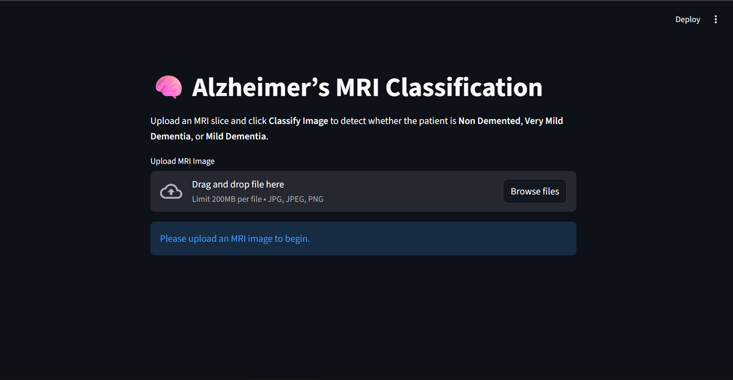
Notes:
Note:
2

Slide 26
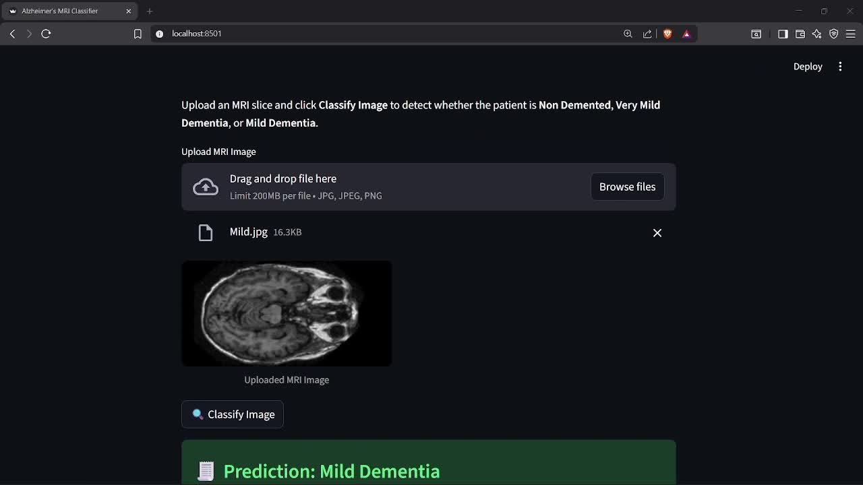

Slide 27

Future Work
Increasing Dataset size to increase the accuracy of the ResNet model
which will make the model more practical in real medical apps
Migrating backend to FastAPI, Flask, or Django for better scalability
Exposing the model as an API and using Streamlit only as a UI.
Samsung Innovation Campus
Notes:
Note:
9

Slide 28

Notes:
14

Slide 29

ⓒ2020 SAMSUNG. All rights reserved.
Samsung Electronics Corporate Citizenship Office holds the copyright of book.
This book is a literary property protected by copyright law so reprint and reproduction without permission are prohibited.
To use this book other than the curriculum of Samsung innovation Campus or to use the entire or part of this book, you must receive written consent from copyright holder.
Notes:
14

